Slide 1
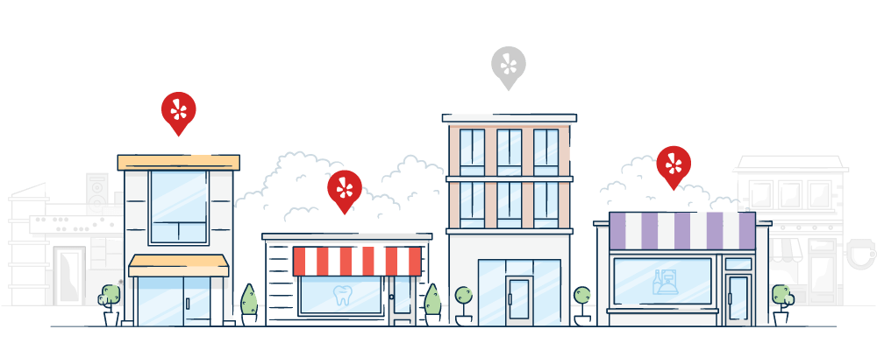

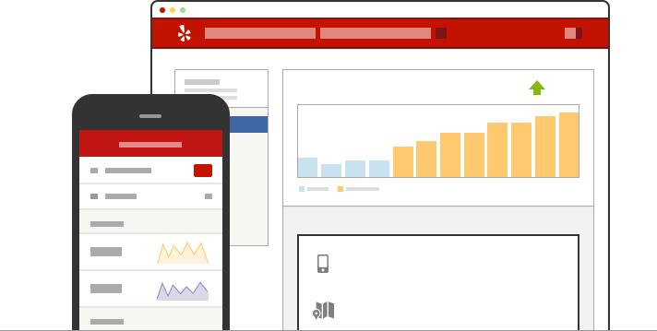
Help Phoenix Restaurants on Yelp Attract More Customers
Section 2 - Group 11 Final Presentation
Chaoying Bao, Ruoyuan Guo, Peisheng Li, Youping Wang

Slide 2
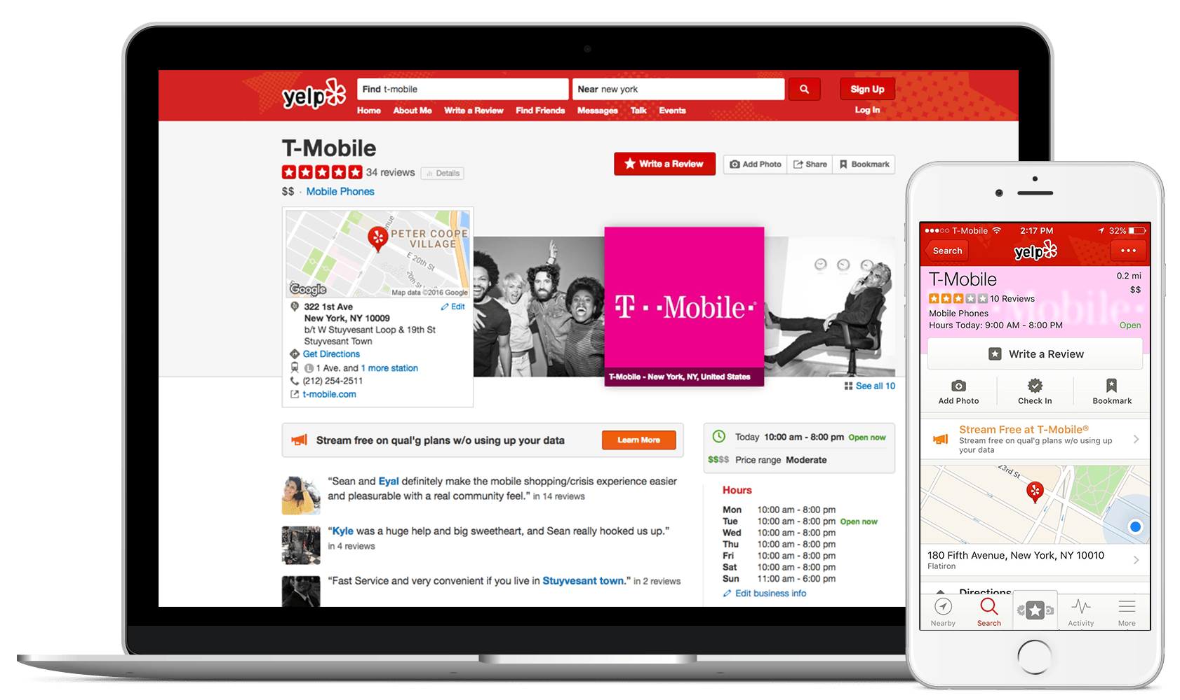
Background
Nowadays, people prefer to use Yelp to find a good restaurant and leave comments for their views on restaurants they have been to.
However, the number of restaurants on Yelp in Phoenix has decreased from 2014 to 2018.
It comes to be worthwhile to analyze customers’ reviews since reviews indicate customers’ real thoughts on restaurants which can help merchants to improve and innovate their restaurants.

Slide 3

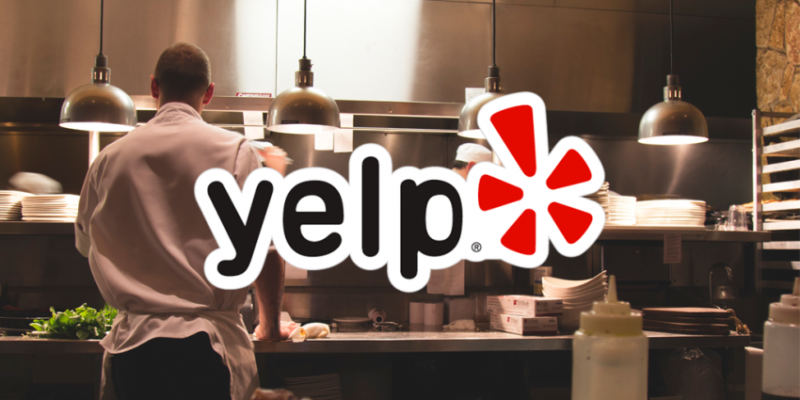
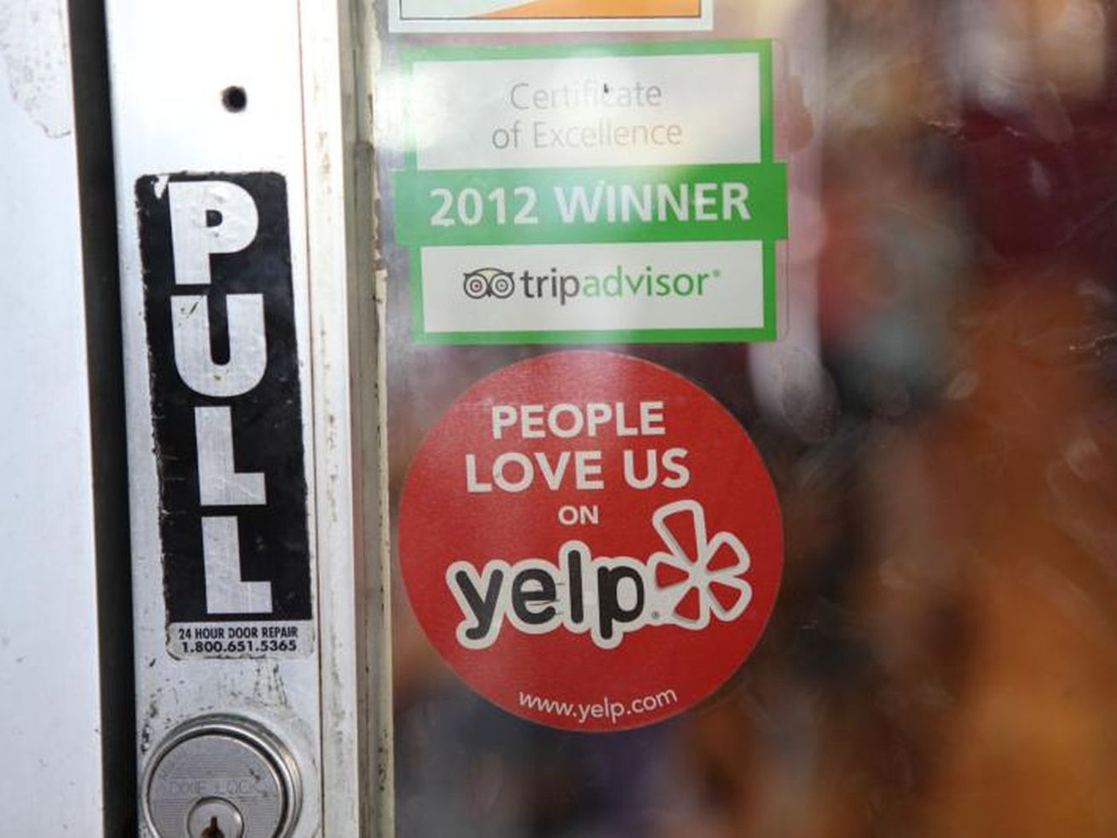
Problem Statement
Explore the factors leading to customers’ satisfaction and dissatisfaction.
Build a recommender system to provide more related information for customers so that restaurants can attract more target customers.

Slide 4

Significance
Help users find their favorite restaurants.
Help restaurant to find their advantages and disadvantages so that they can utilize and improve them to increase their sales.
Increase the usage of Yelp in Phoenix.

Slide 5

Data Collection
Yelp Dataset: https://www.yelp.com/dataset/download

Slide 6
Data Description
Name | Size | Type | Description
Business | 131MB | JSON | Contains business data including location data, attributes, and categories.
Review | 4.97GB | JSON | Contains full review text data including the user_id that wrote the review and the business_id the review is written for.
User | 2.31GB | JSON | User data including the user's friend mapping and all the metadata associated with the user.

Slide 7







Methodology - Overall
Data Collection
Descriptive Stats & Data Preprocessing
Variables Selection
Model Building
Evaluation

Slide 8
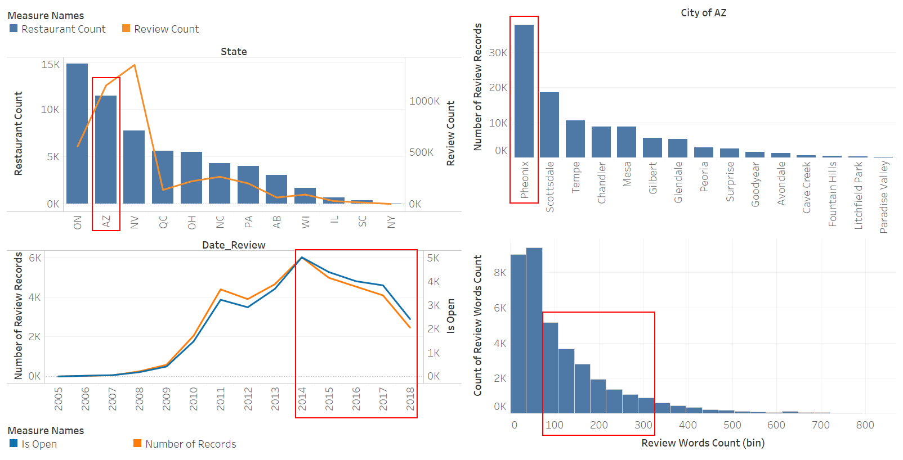
Descriptive Stats

Slide 9
Data Preprocessing
Convert Large JSON File to DataFrame
Select Arizona as Target State
Tokenize the Reviews
Step 1
Step 3
Step 5
Step 2
Step 4
Step 6
Select Businesses with the Restaurant Category
Select Phoenix as Target City
Select Reviews with 70-300 Words from 2014 to 2018

Slide 10
Variables Selection
Variable Type | Variable Name | Definition | Data Type | Example
Independent Variable | useful | Number of useful votes sent by the user | Integer | 0
 | funny | Number of funny votes sent by the user | Integer | 0
 | cool | Number of cool votes sent by the user | Integer | 0
 | postal_code | Postal code of a restaurant | String | 94107
 | review_count | Number of reviews of a restaurant | Integer | 1198
 | review_words_counts | Number of words in a review | Integer | 68
 | negative | Negative score of a review calculated by NLTK Vader | Float | 0.022
 | neutral | Neutral score of a review calculated by NLTK Vader | Float | 0.856
 | positive | Positive score of a review calculated by NLTK Vader | Float | 0.121
 | compound | Compound score of a review calculated by NLTK Vader | Float | 0.9664
 | “0” - “9” | Weight of 10 topics that were modelled based on POS noun tags in a review | Float | 0
Dependent Variable | rating_group | Two groups of business ratings | Integer | 0

Slide 11
Model Building
Tokenization
Classification
POS
Sentiment Analysis
Preprocessed Data
Stopwords Removal
Topic Modeling
Porter Stemming
Recommender System
TFIDF

Slide 12
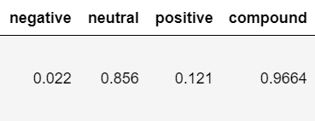
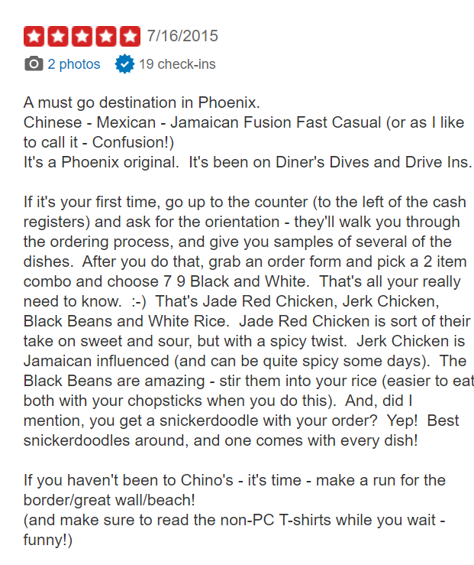
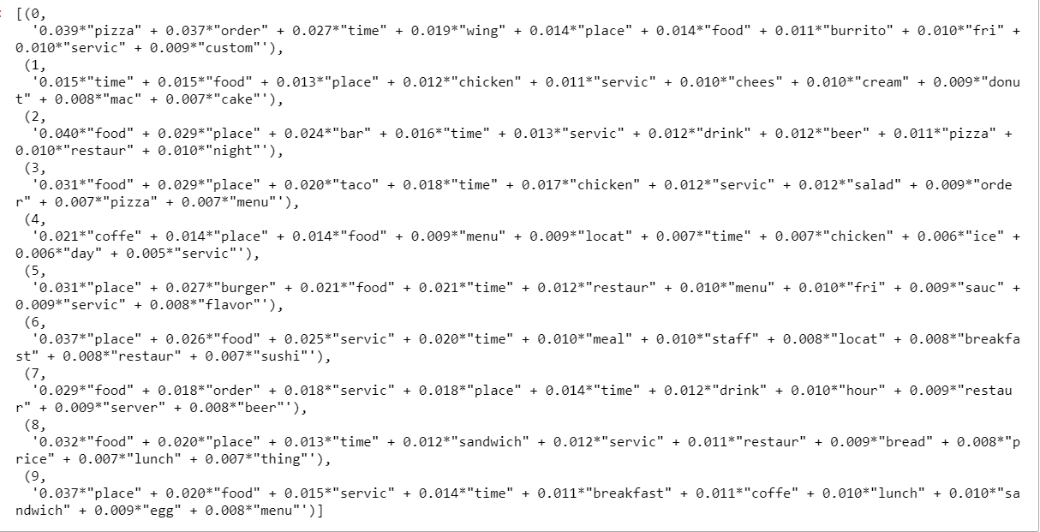
Rating Prediction
Sentiment Analysis
POS
Stopwords Removal
Classification
Porter Stemming
Topic Modeling
Generate Term-Document Matrix
LDA

Slide 13
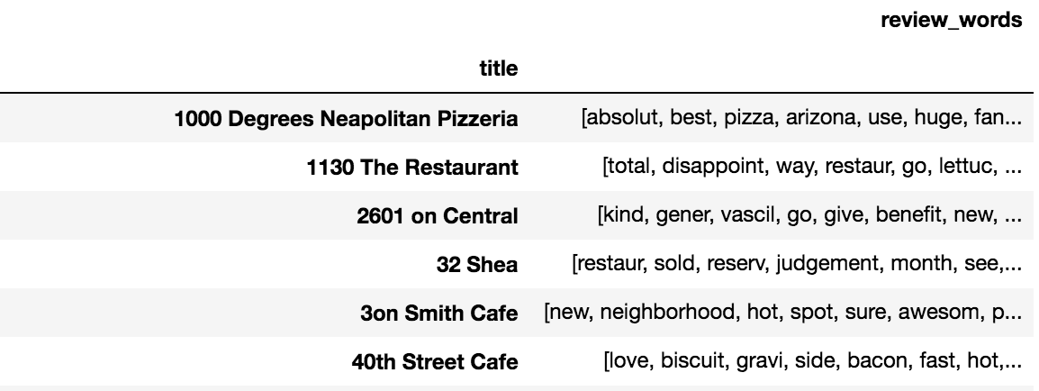
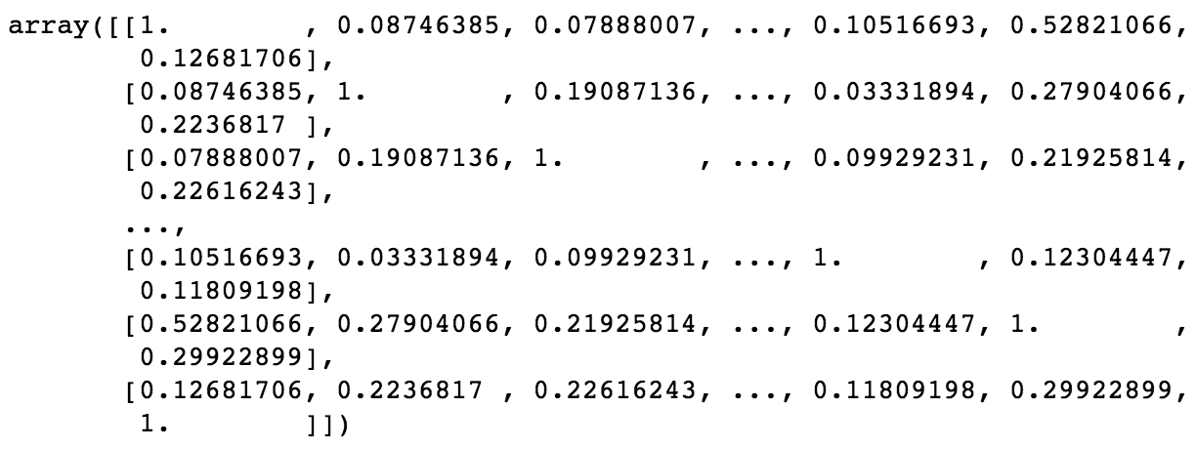
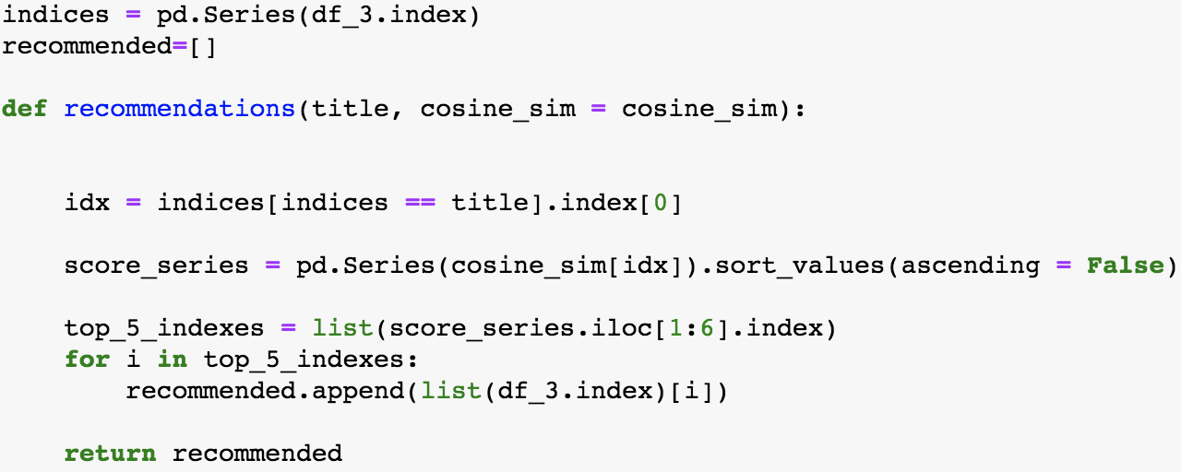
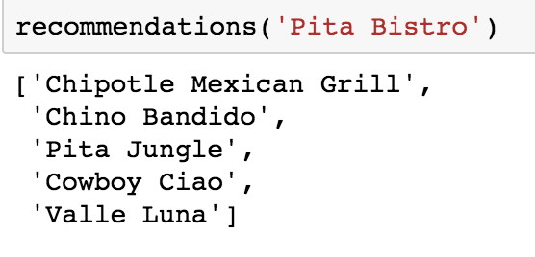
Content-based Recommender System
Approach 1- Recommending based on the similarity of item contents[3]
Step 1: Restaurant names and reviews_words were grouped by the restaurants’ names and put into a new DataFrame.
Step 2: Use cosine similarity function to analyze similarities between restaurants
Step 3: Build the function that takes names as input, and returns the top 5 similar restaurants

Slide 14
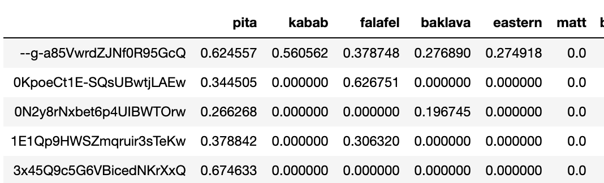
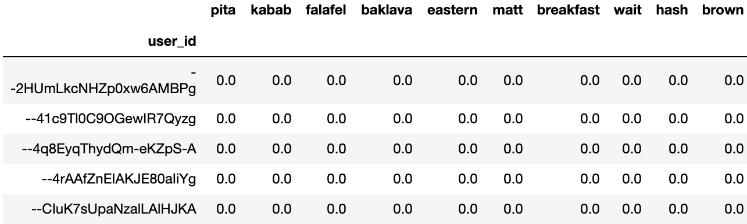
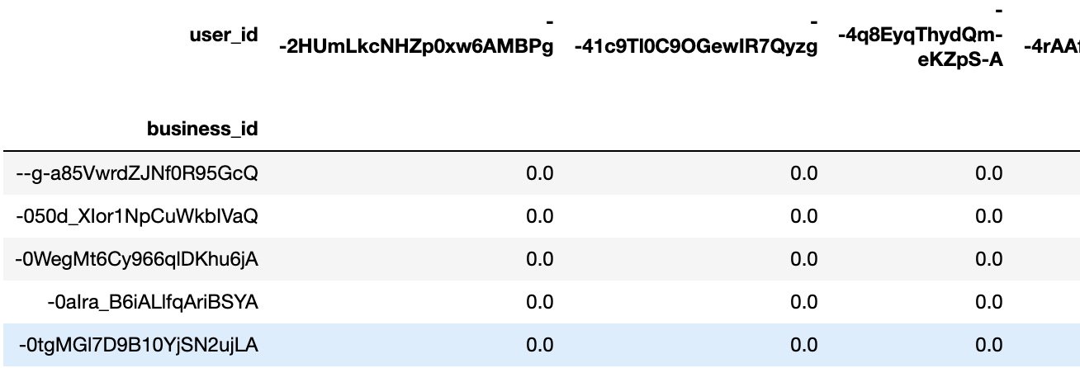
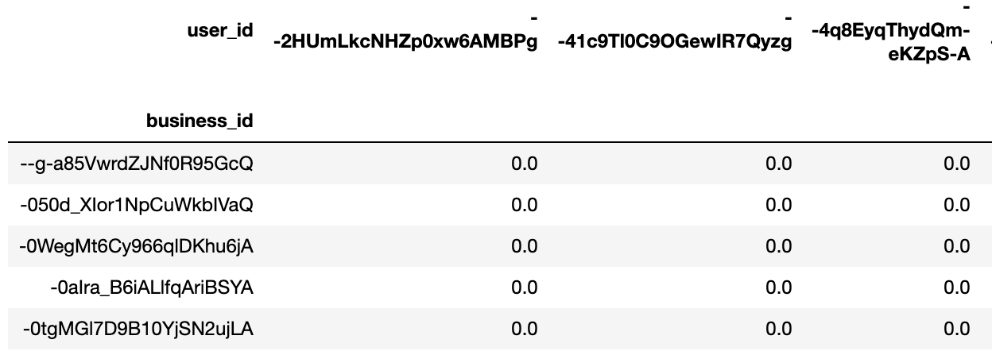
Content-based Recommender System
Approach 2 - Recommending based on the prediction of user’s rating [4]
Step 1: Create item profile with TFIDF scores
(2993 restaurants * 6744 keywords)
Step 3: Generate user’s preference profile
(14510 users * 6744 keywords)
Step 2: Create user profile with users’ rating
(2993 restaurants * 14510 users)
Step 4: Compute the predicted rating
(2993 restaurants*14510 users)

Slide 15
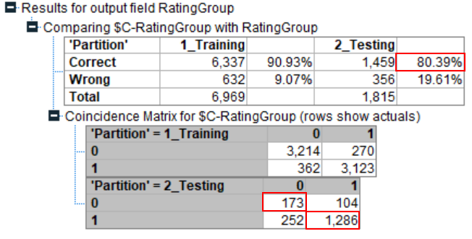
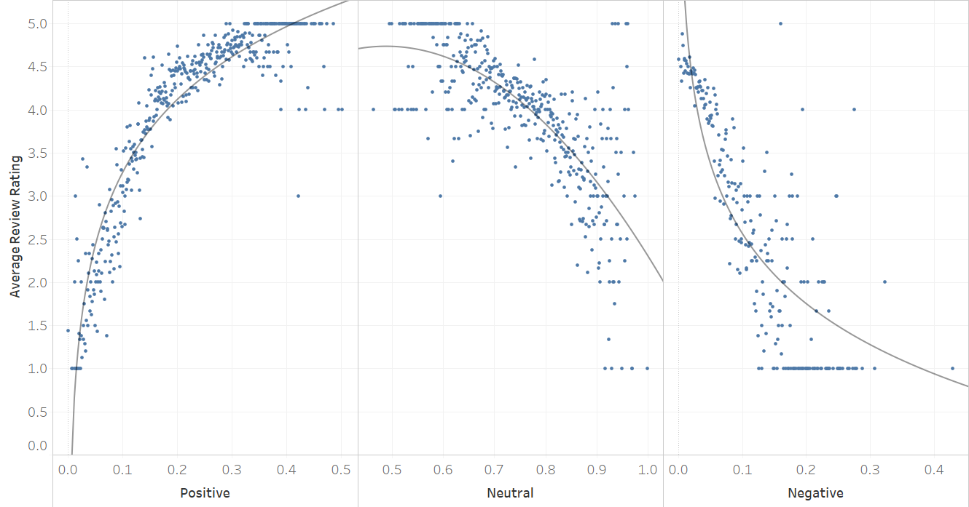
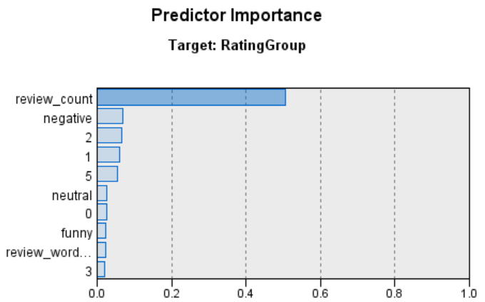
Results - Rating Prediction

Slide 16
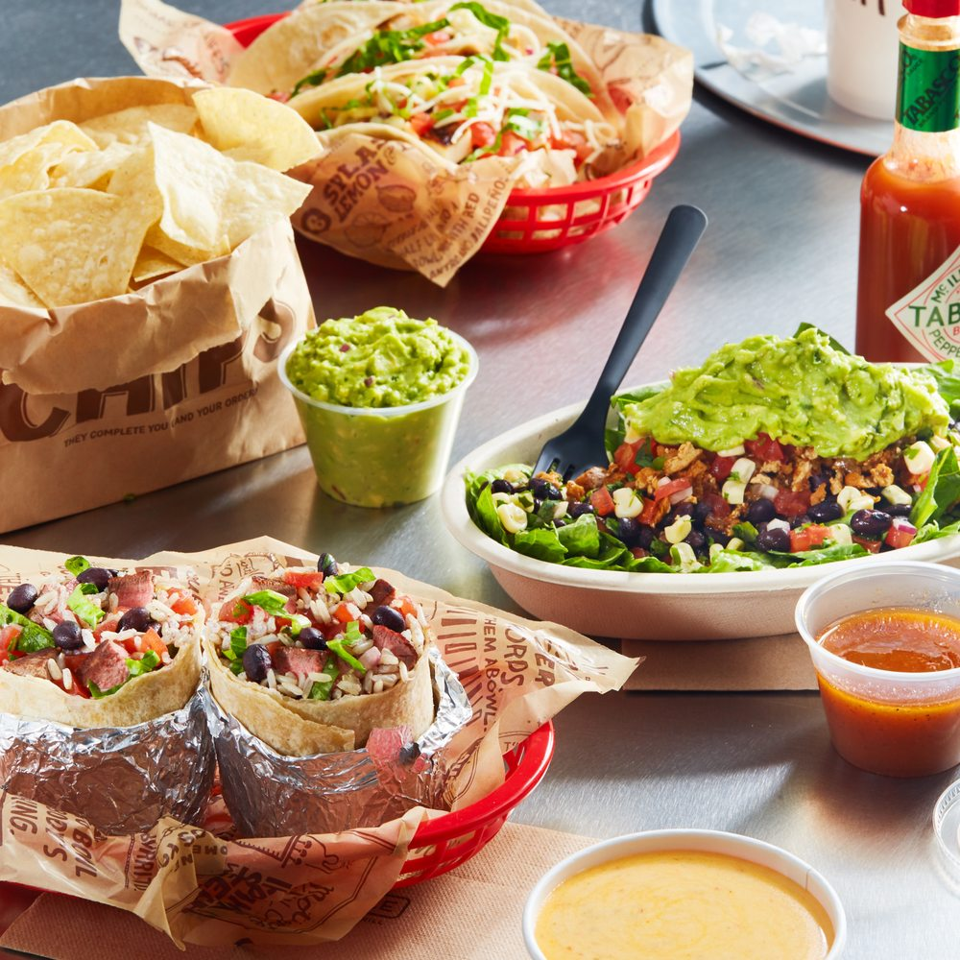
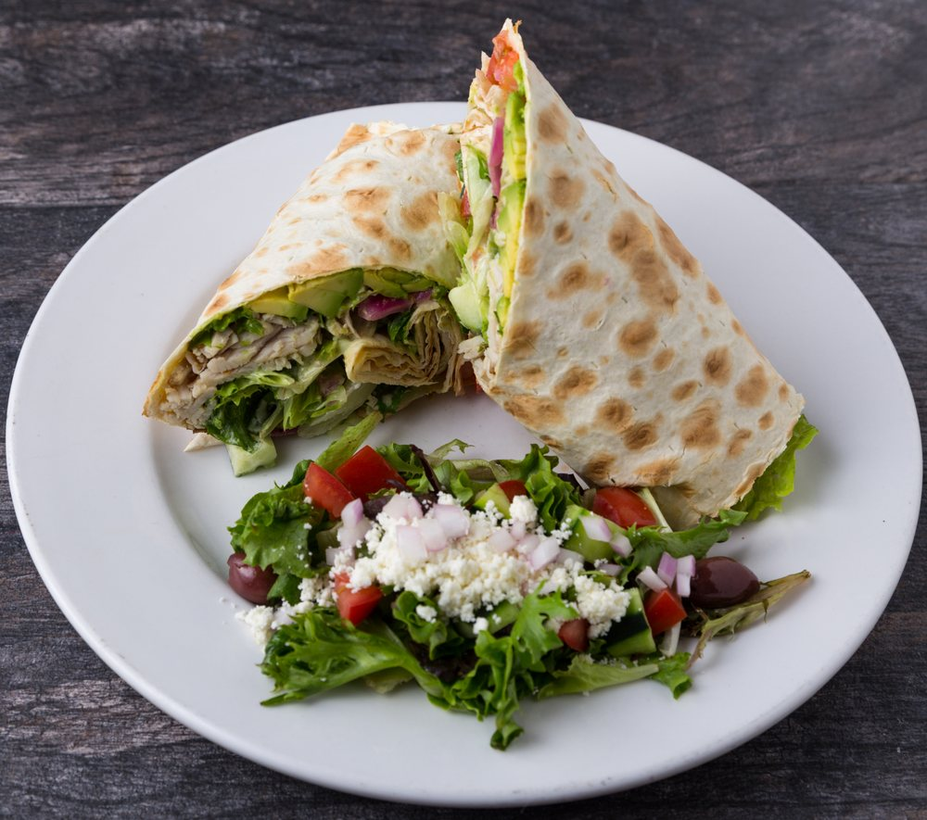
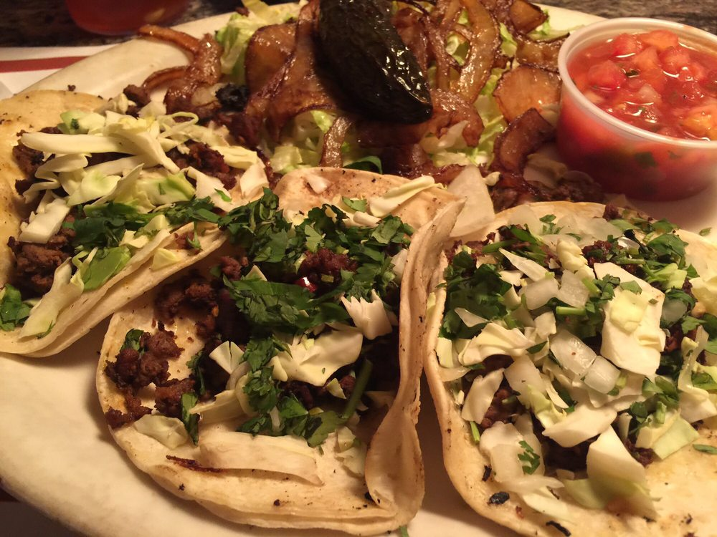
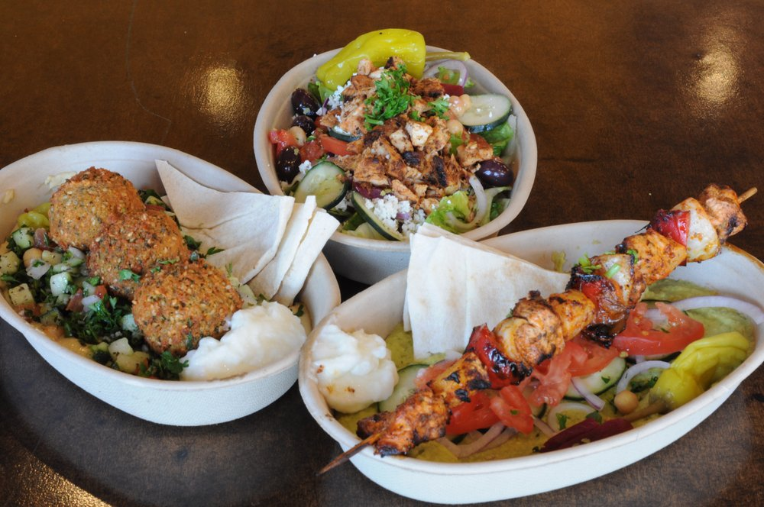
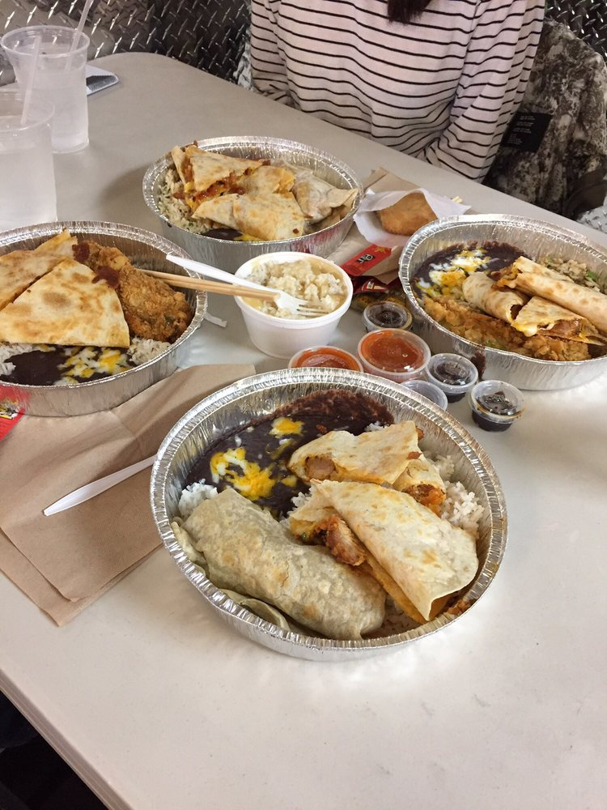
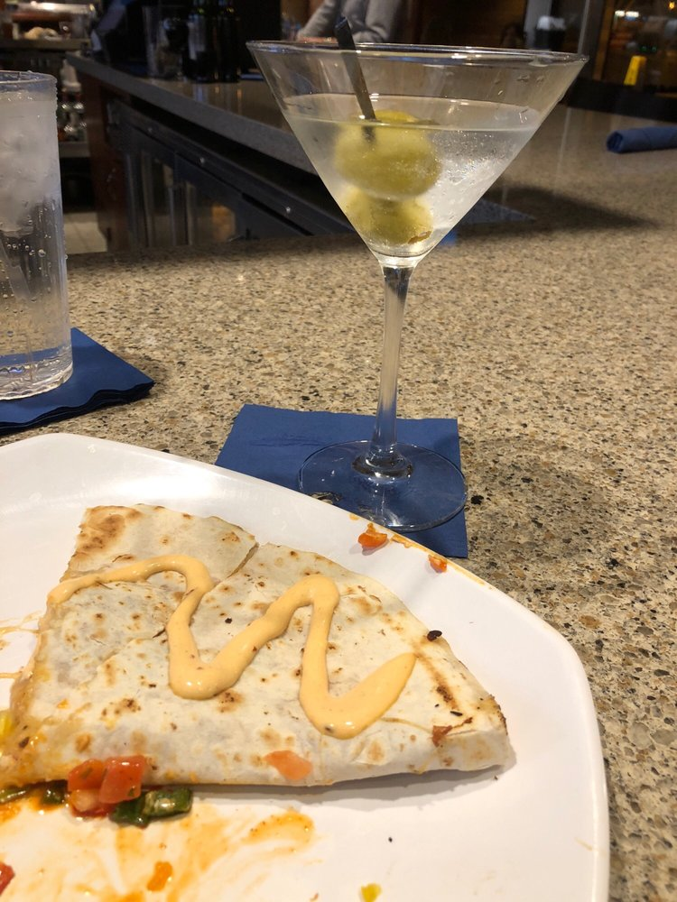
Results - Recommender System (Approach 1)
Recommend
Chipotle Mexican Grill
Pita Jungle
Valle Luna
Pita bistro
Chino Bandido
Cowboy Ciao

Slide 17
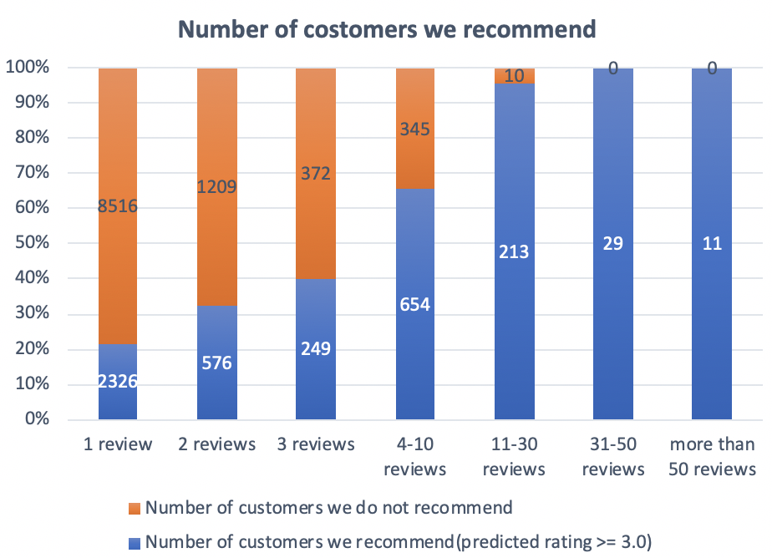
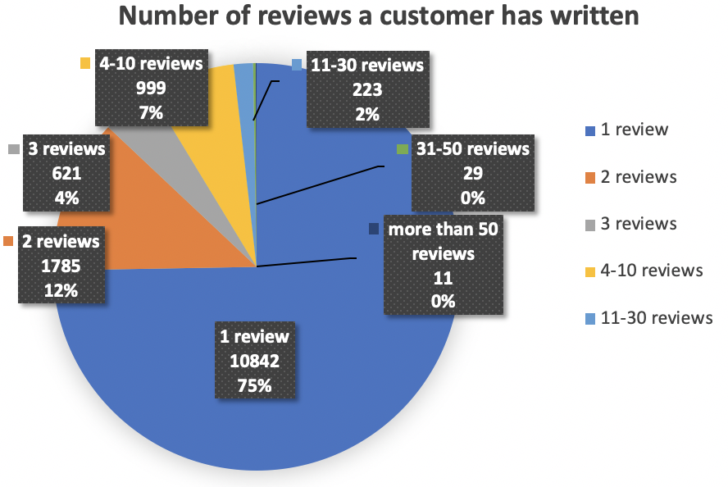
Results - Recommender System (Approach 2)
There are 14510 customers in our dataset before selecting reviews with 70-300 words and special years, but 10842 customers (75%) only have one review.
As the user provides more inputs, the engine becomes more and more effective.
For users who created less than 10 reviews in our user profile, our recommender system with the first approach recommends better.

Slide 18
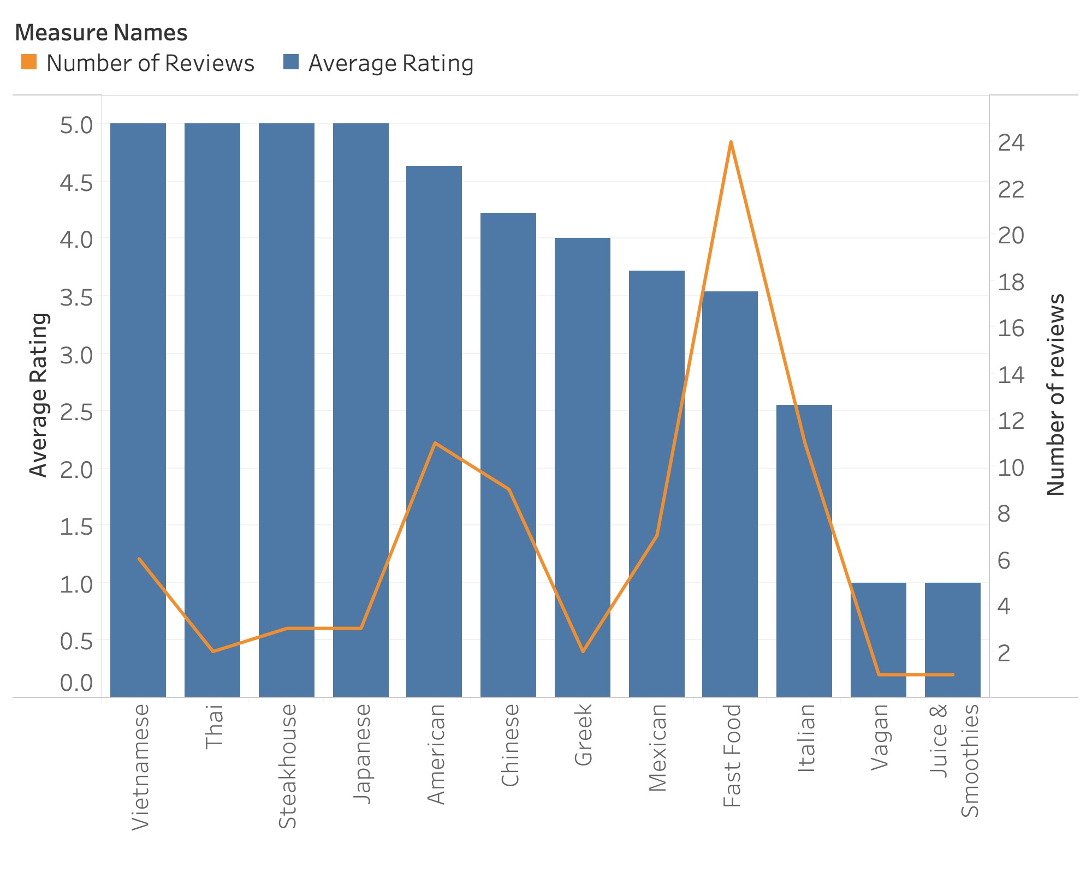
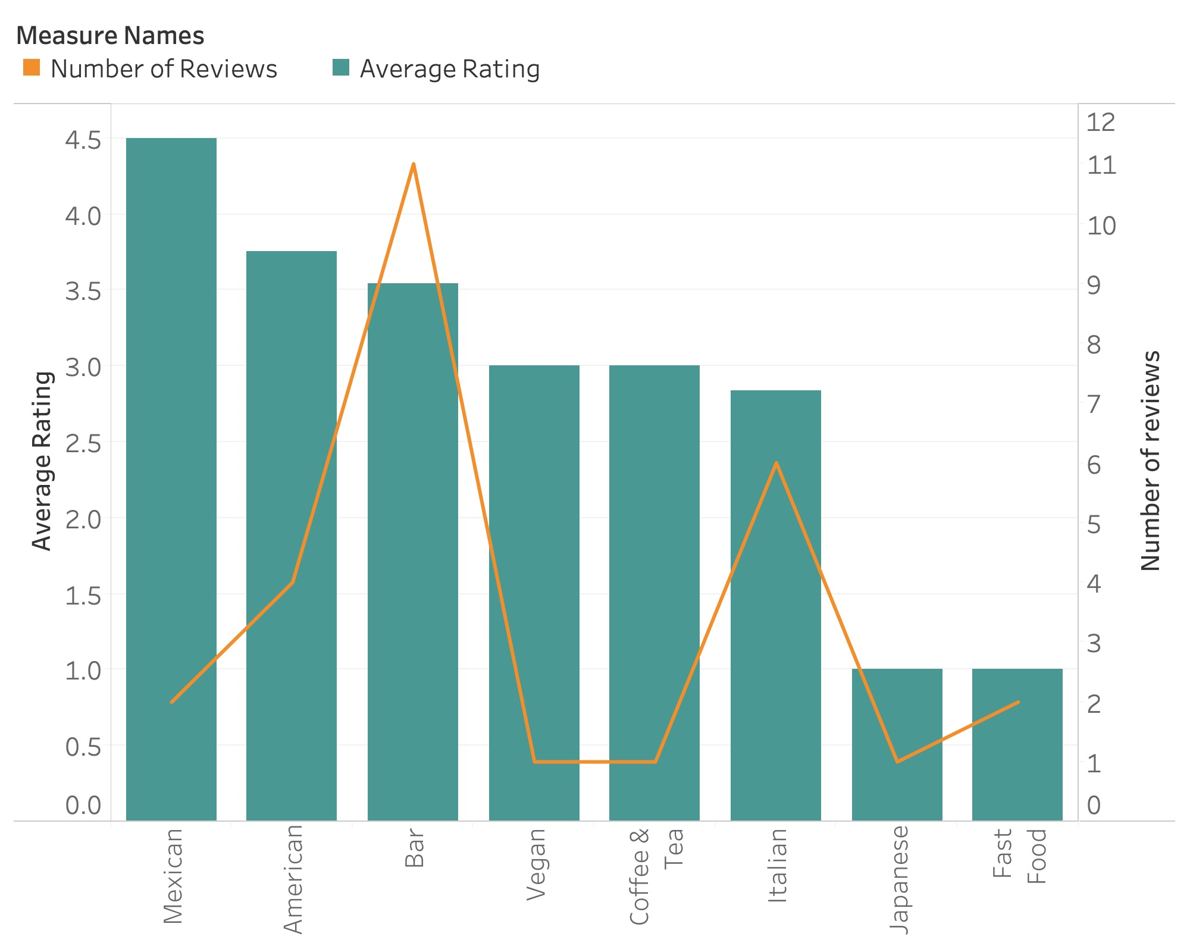
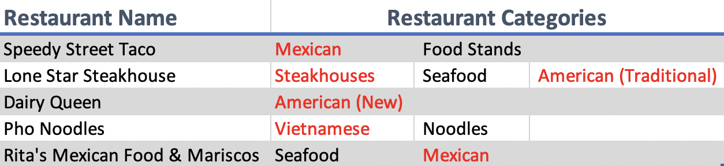
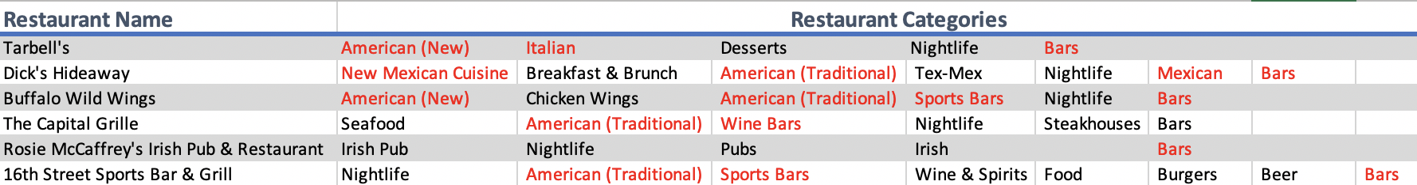
Results - Recommender System (Approach 2)
User 1: Taylor
80 records in user profile
Often writes reviews for Fast Food and American restaurants
Loves Vietnamese, Thai, Steakhouse, Japanese and American foods.
User 2: Cris
28 records in user profile
Often writes reviews for Bar and Italian restaurants
Loves Mexican and American food, enjoys bar as well
Restaurants we recommend
Restaurants we recommend

Slide 19

Conclusions
For Restaurants
Customers’ sentiment in reviews is significantly related to the actual rating they give the restaurants, so restaurants shouldn’t ignore customers’ reviews.
Based on the model, the number of reviews a restaurant receives, the negative score in a review, and topic 2, 1, and 5 are important predictors for the restaurant rating.
For Customers
For new users or users who have limited records, the recommender system (approach 1) could be used to recommend restaurants based on the similarity of each restaurant’s reviews.
For other users with enough records, the recommender system (approach 2) should be used, since it takes user’s preference into consideration.

Slide 20
Recommendation
For Restaurants
Topic 2, 1, and 5 all mention food, time, place, and service. Based on our model, the more related to these three topics, the more likely a restaurant to get low rating. Therefore, those restaurants who get low rating should pay more attention to these aspects and improve them.
For Customers
Since the number of reviews is the most important predictor for the restaurant rating, customers are recommended to write reviews about their opinions, which will contribute to not only the restaurant’s improvement, but also the customers’ future experience.

Slide 21
Project timeline
Project Proposal
Choose an application domain
Find a publicly available dataset
Identify a NLP problem
Apply appropriate techniques to solve this problem
Model building
Writing code to build models
Compare the performance of multiple techniques
Final Report
Write final report
Prepare for final presentation
3/4 - 3/11
4/1 - 4/15
2/29 - 3/4
3/11 - 4/1
4/15 - 4/22
Data Preprocessing
Data cleaning
Data transformation
Data reduction
Evaluation
Evaluate the results of different restaurants
Gain business insights

Slide 22
References
[1] https://github.com/karantyagi/Restaurant-Recommendations-with-Yelp
[2] https://monkeylearn.com/text-mining/
[3]https://towardsdatascience.com/how-to-build-from-scratch-a-content-based-movie-recommender-with-natural-language-processing-25ad400eb243
[4]https://www.analyticsvidhya.com/blog/2015/08/beginners-guide-learn-content-based-recommender-systems/

Slide 23
Thanks!
Chaoying Bao, Ruoyuan Guo, Peisheng Li, Youping Wang

